Slide 1
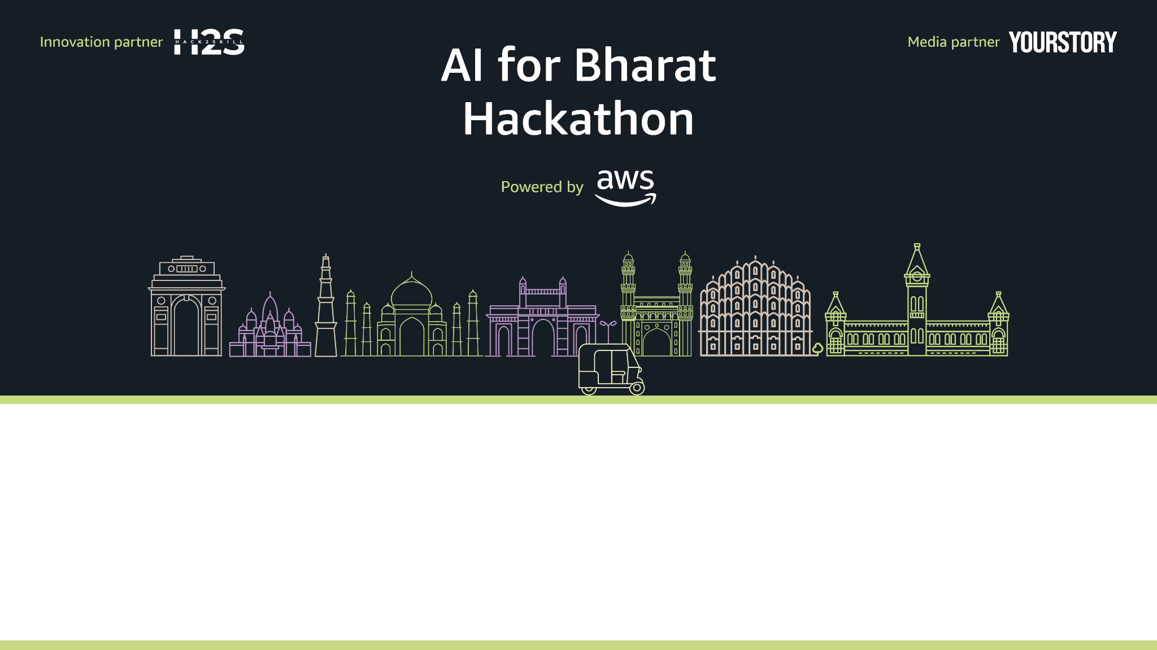
Team Name : Torvia Systems
Team Leader Name : Sharaj M M
Problem Statement : Citizens struggle with fragmented portals, misrouted complaints, and delayed responses, while governments lack real‑time visibility into infrastructure risks and public grievances. A unified AI‑powered interface is needed to verify, route, and monitor civic and grievance issues efficiently and inclusively.

Slide 2

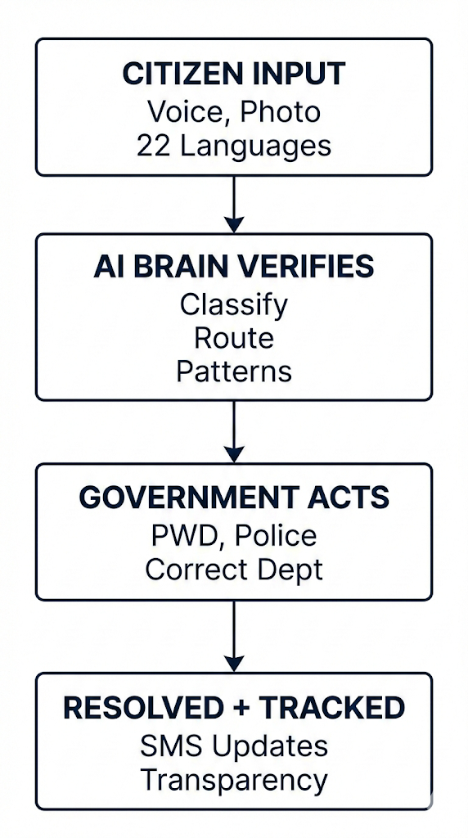
JAN‑DRISHTI: AI‑POWERED UNIFIED CIVIC INTELLIGENCE PLATFORM
Jan‑Drishti is an AI‑native governance intelligence layer that transforms citizen inputs into verified, structured, and actionable signals for government systems.
Instead of being just another complaint portal, Jan‑Drishti uses AI to:
Verify infrastructure issues using computer vision
Understand voice complaints in 22 Indian languages
Automatically route issues to correct departments
Detect patterns and early infrastructure risks
Provide real‑time feedback and transparency to citizens
Outcome: Faster response, early risk detection, and inclusive governance for every citizen.

Slide 3
HOW IS IT DIFFERENT?
HOW IT SOLVES THE PROBLEM?
USP
Existing systems:
Passive complaint forms
Manual routing
No verification
No pattern intelligence
Jan‑Drishti:
AI verifies, understands, prioritizes, and routes automatically
Converts raw citizen input into actionable government intelligence
Jan‑Drishti acts as an intelligent layer that:
Removes manual routing errors
Filters spam and validates evidence
Enables voice‑based reporting for low‑literacy users
Detects infrastructure risks early through clustering
Jan‑Drishti is not a complaint portal. It is an AI‑powered national intelligence layer for governance.
Key USP points:
AI‑verified citizen reports
Automatic department routing
Pattern‑based early risk detection
Voice‑first inclusion
Seamless integration with existing government systems

Slide 4
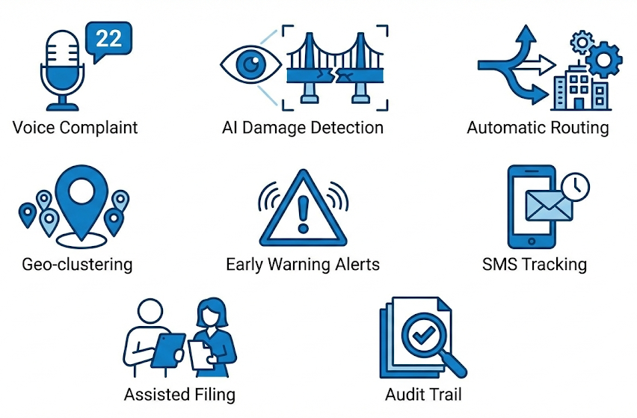
LIST OF FEATURES OFFERED BY THE SOLUTION
Voice complaint in 22 Indian languages
AI‑based infrastructure damage detection
Automatic routing to correct department
Geo‑clustering and pattern detection
Early warning alerts for infrastructure risks
Real‑time citizen status tracking via SMS
Assisted filing via CSC and community helpers
Transparent audit trail and escalation system

Slide 5
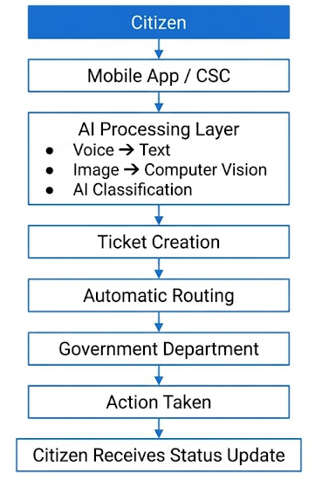
PROCESS FLOW DIAGRAM:
AI transforms citizen input into verified, routed, and actionable governance intelligence making it easy for government to prioritize and take action.

Slide 6
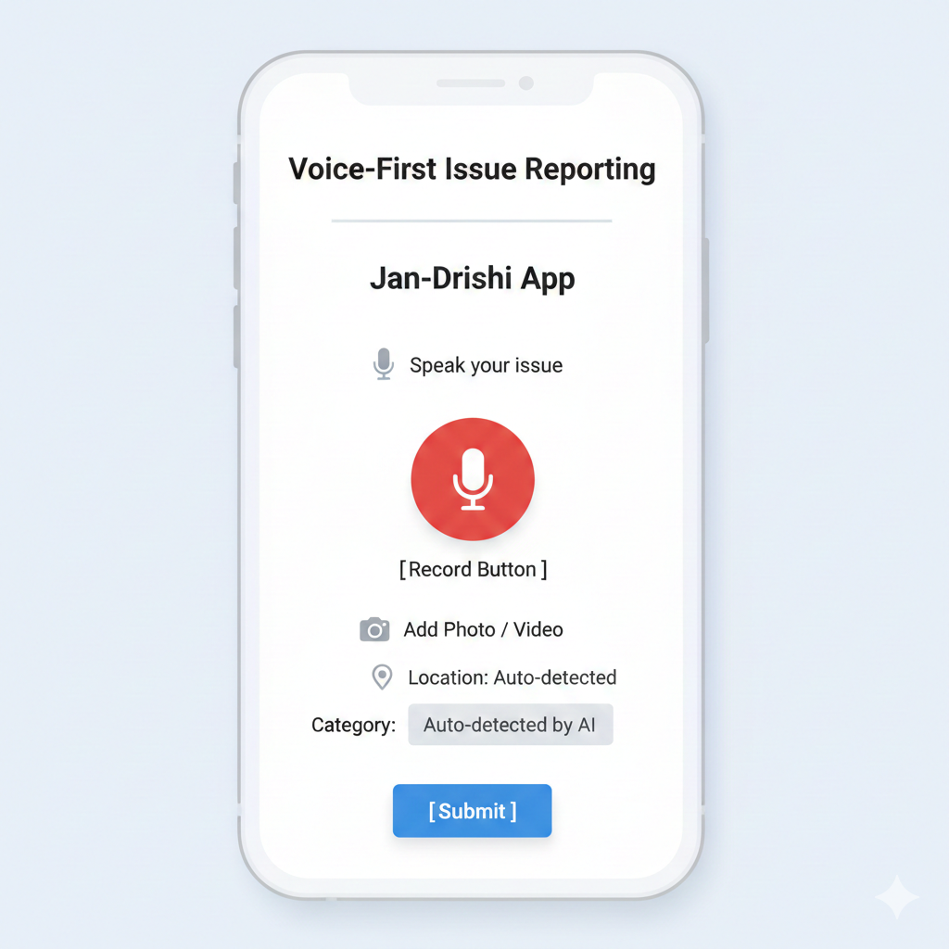
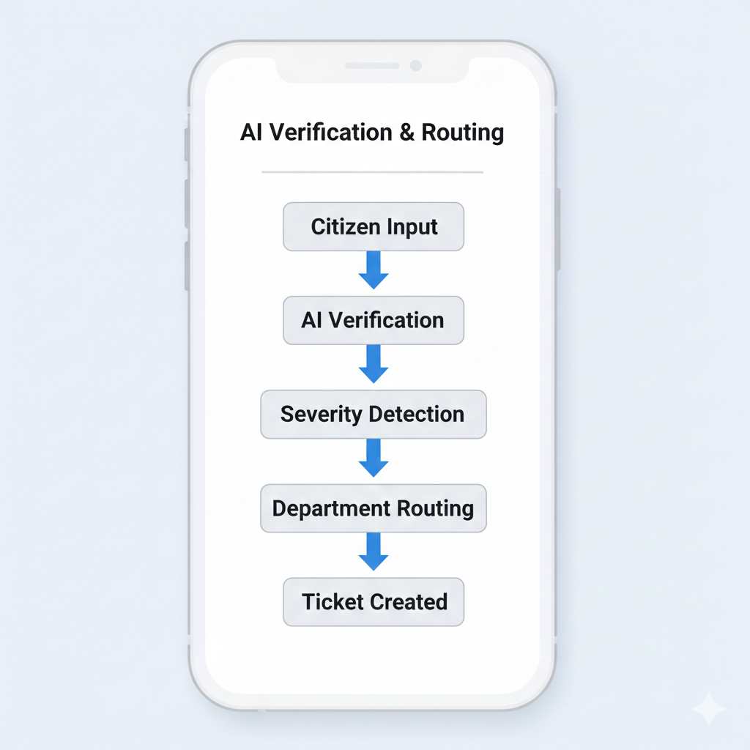
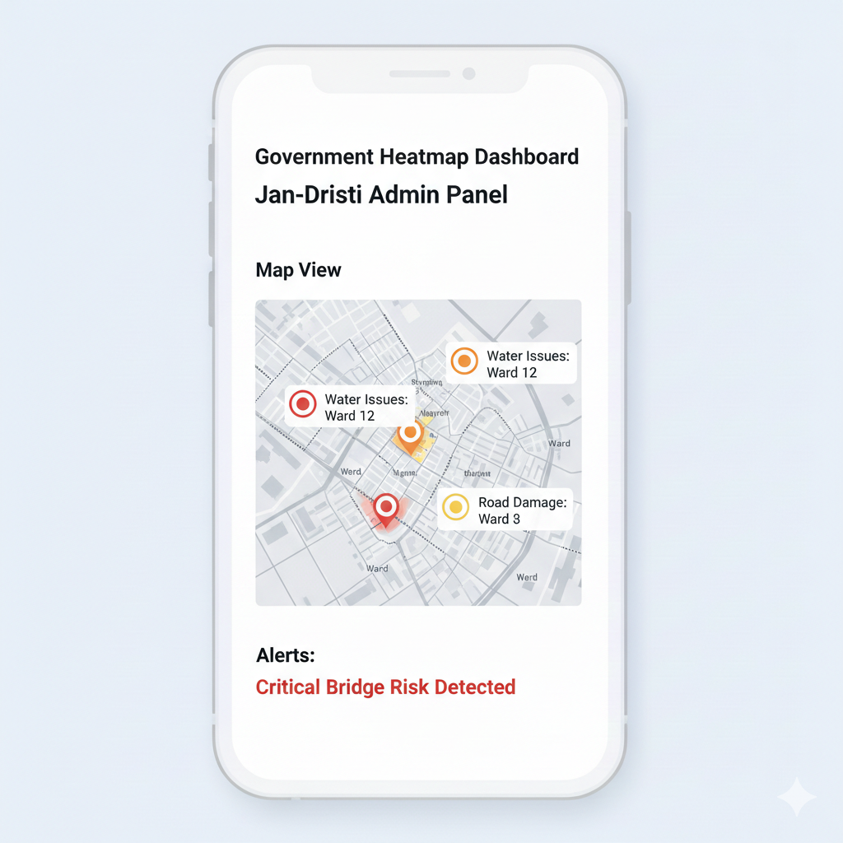
MOCK SCREEN OF JAN-DRISHTI:
Citizen App → AI Engine → Government Dashboard
AI converts voice, verifies evidence, and auto‑routes issue
AI validates, prioritizes, and routes automatically
Officials see real‑time civic intelligence
The above images are very minimal and for mock only, they are not actual screens

Slide 7
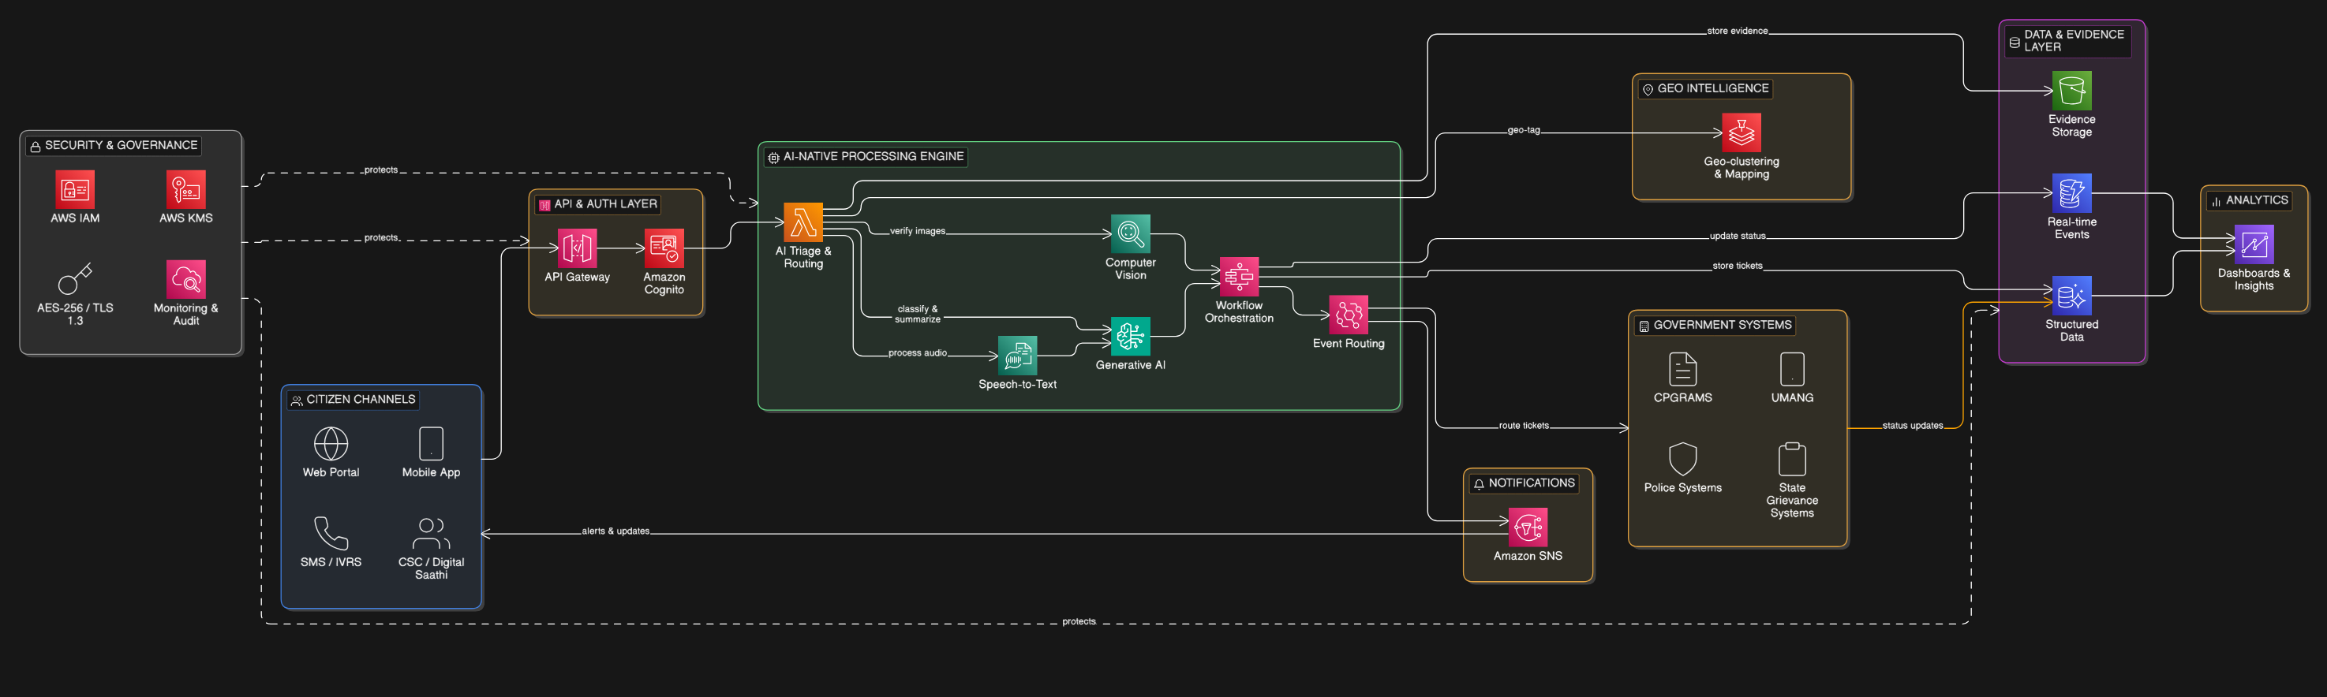
ARCHITECTURE DIAGRAM OF THE PROPOSED SOLUTION:
Serverless AI architecture enabling scalable, secure, and intelligent governance processing.
Citizen → Amplify → Lambda → Bedrock/Rekognition → DynamoDB/Aurora → Government Systems → Citizen Notification

Slide 8

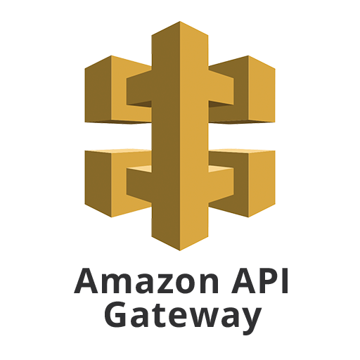
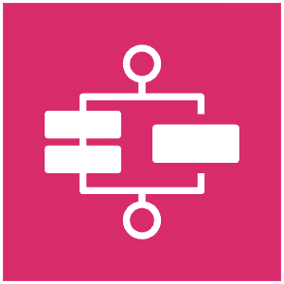



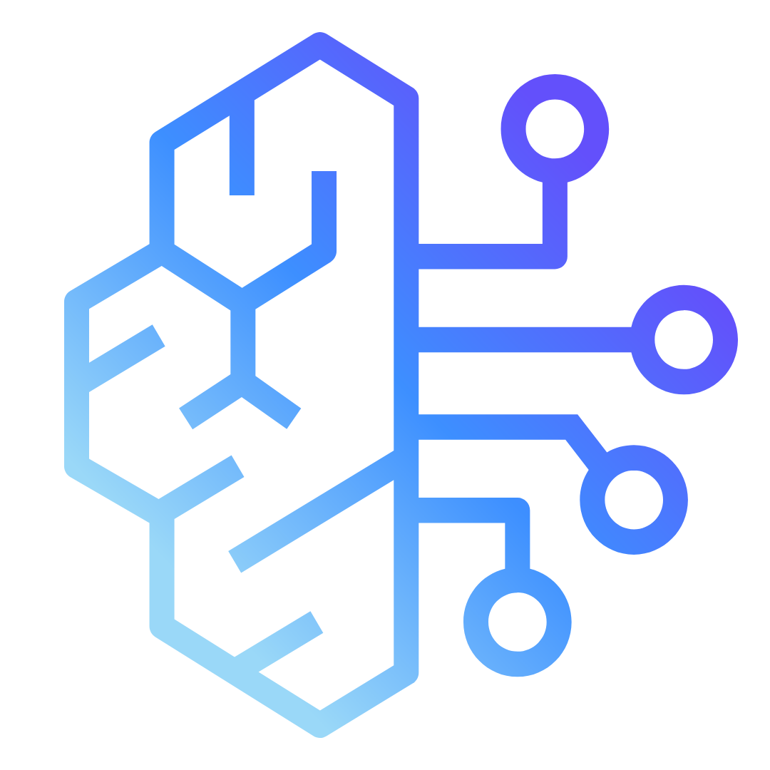








TECHNOLOGIES TO BE USED IN THE SOLUTION:
BACKEND
AI & INTELLIGENCE
AWS Rekognition
AWS Bedrock
Claude ai
Bhashini
AWS Lambda
AWS Gateway
AWS Step functions
DATABASE & STORAGE
FRONTEND & ANALYTICS
AWS DynamoDB
AWS Aurora
AWS S3
AWS Amplify
React Native
AWS Location
QuickSight

Slide 9
ESTIMATED IMPLEMENTATION COST:
Prototype cost:
Cloud usage: ₹3,000 – ₹10,000/month Development: Student‑built prototype Infrastructure: Serverless (pay‑per‑use)
Scaling benefit:
Serverless architecture enables national‑scale deployment without heavy infrastructure investment.
Highly scalable with minimal operational cost due to serverless AI architecture.

Slide 10
IMPACT
1. Early Detection → Prevent Disasters
AI detects infrastructure risks (bridge cracks, pipeline failures, road hazards) early using citizen signals, enabling preventive action before failures, saving lives and public funds.
2. Inclusion of Every Citizen (Voice‑First Governance)
Enables illiterate, rural, and non‑technical citizens to access governance using voice in 22 Indian languages via CSCs, mobile, and assisted interfaces.
3. Faster Resolution & Higher Government Efficiency
Automates verification, routing, and triage, reducing manual workload, eliminating duplicate complaints, and enabling faster, more accurate issue resolution.
4. Real‑Time National Civic Intelligence Layer
Transforms millions of complaints into actionable intelligence, helping government understand citizen pain points, infrastructure health, and policy needs in real‑time.
VISION:
Build India’s AI‑Powered Digital Nervous System
Shift from Reactive Governance → Predictive Governance
One Unified AI Interface for 1.4 Billion Citizens
Foundation for Future Smart Nation Infrastructure

Slide 11
